Slide 1
Coordinate: A Virtual Classroom Management Tool For Large Computer Science Courses Using Discord
Thursday, February 27, 2025
ACM SIGCSE TS 2025, Pittsburgh, PA
Cameron Brown
Dr. Laura Cruz Castro

Slide 2
Introduction
Growing computer science courses and the need for classroom management

Slide 3
Classroom management
Classroom management is critical for student experience (Korpershoek et al.) [1]
Virtual classroom management is an important part of these students’ experiences [2] [3]
What are some of the things that are consider classroom management?
Communication with students
Discussion & Q&A
Attendance & Participation Tracking
Assignment extensions
… And many more tasks that someone less specialized could do
Due to a large computer science enrollment, and hybrid and completely online education this is critical to our community
However, classroom management is time consuming

Slide 4
Tools for classroom communication
Software tools are increasingly relied upon for classroom management.
Among them communication tools such as: Slack [4][5], Piazza [7], and Microsoft Teams [6] help streamline the communication with students
While they improve communication, they require continuous management and oversight
Adopting these technologies benefits the classroom but adds to the instructor’s workload [10]

Slide 5
The case of a large introductory CS class
Managing a class 1 instructor, 600 students (approx), and 25+ peer mentors
Key Classroom Management Tasks:
Approving & Adjusting Deadlines – Ensuring fairness and flexibility for students.
Providing Accommodations – Extending time for those in need.
Managing Office Hours – Coordinating schedules for 25+ peer mentors.
Reducing Wait Times – Addressing long queues for student support.
Handling Repetitive Questions – Improving communication efficiency on our platform.
While using a communication tool helped students, it did not have much benefit for the instructional team.
Many students assume the instructional team is always accessible.
Some inquiries were asked multiple times… yes, even five times!

Slide 6
At the end of Fall 2022, we transitioned to Discord as our communication platform.
Accessibility and cost
It has been used before and it has proven to be beneficial to CS students in the classroom, in engaging them and building community [8][9]
Student prefer efficiency and familiarity
30% of Discord users today use the platform for non-gaming purposes [1]
Customization
As a result, Coordinate was born.
A generic educational platform using Discord, not intimately tied into a particular learning management system
An easily-maintainable tool that everyone could contribute to
Notes:
– Discord is a free platform, ensuring equal access for all students.
Studies and classroom experiences have demonstrated its potential to enhance student interaction and participation. []
– Anecdotal evidence suggested that many students were already using Discord, allowing us to meet them where they are.
– Discord’s features enabled us to develop tools that streamlined communication, saving time while improving responsiveness.

Slide 7
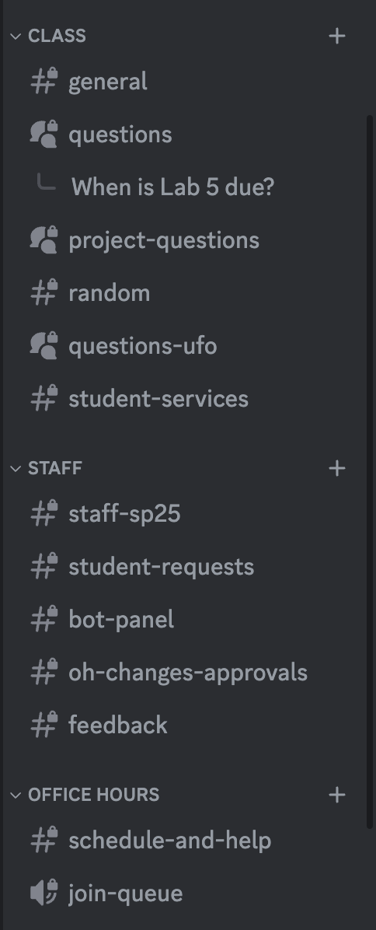
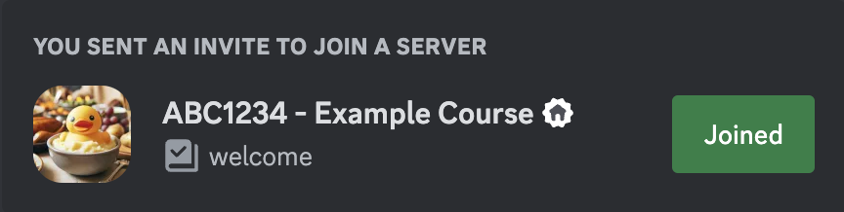
Introducing Discord
Channels
VoIP-based chat-app created in 2015, originally focused on gaming content
Several useful features:
Categories
Guild/Server

Slide 8
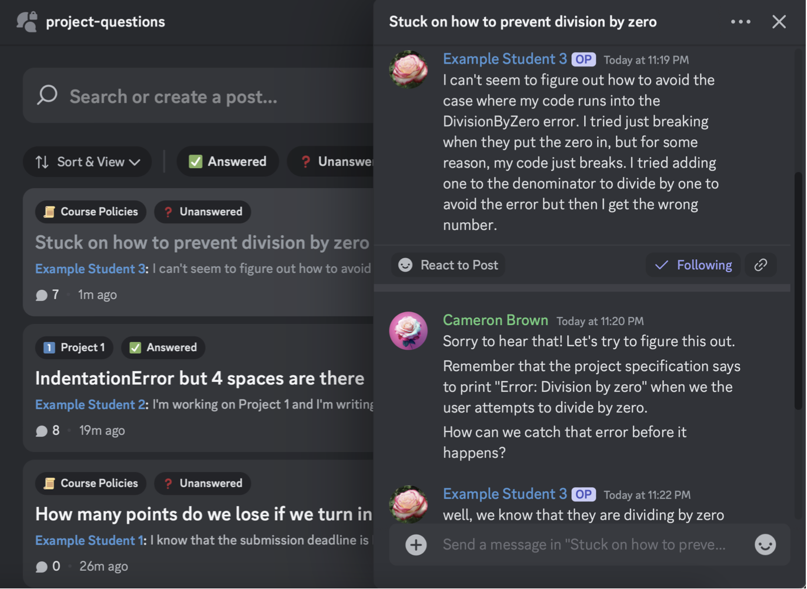
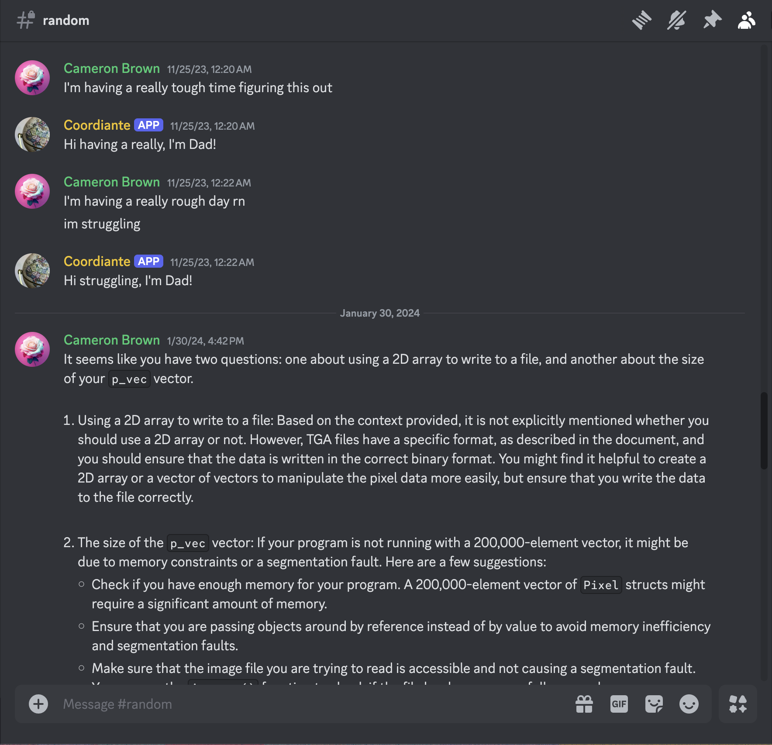
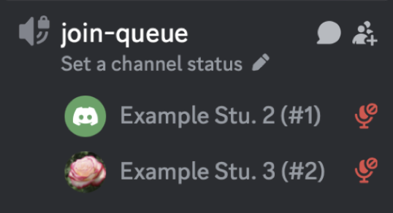
Introducing Discord
Forum Channels
Text Channels
Voice/VoIP Channels

Slide 9
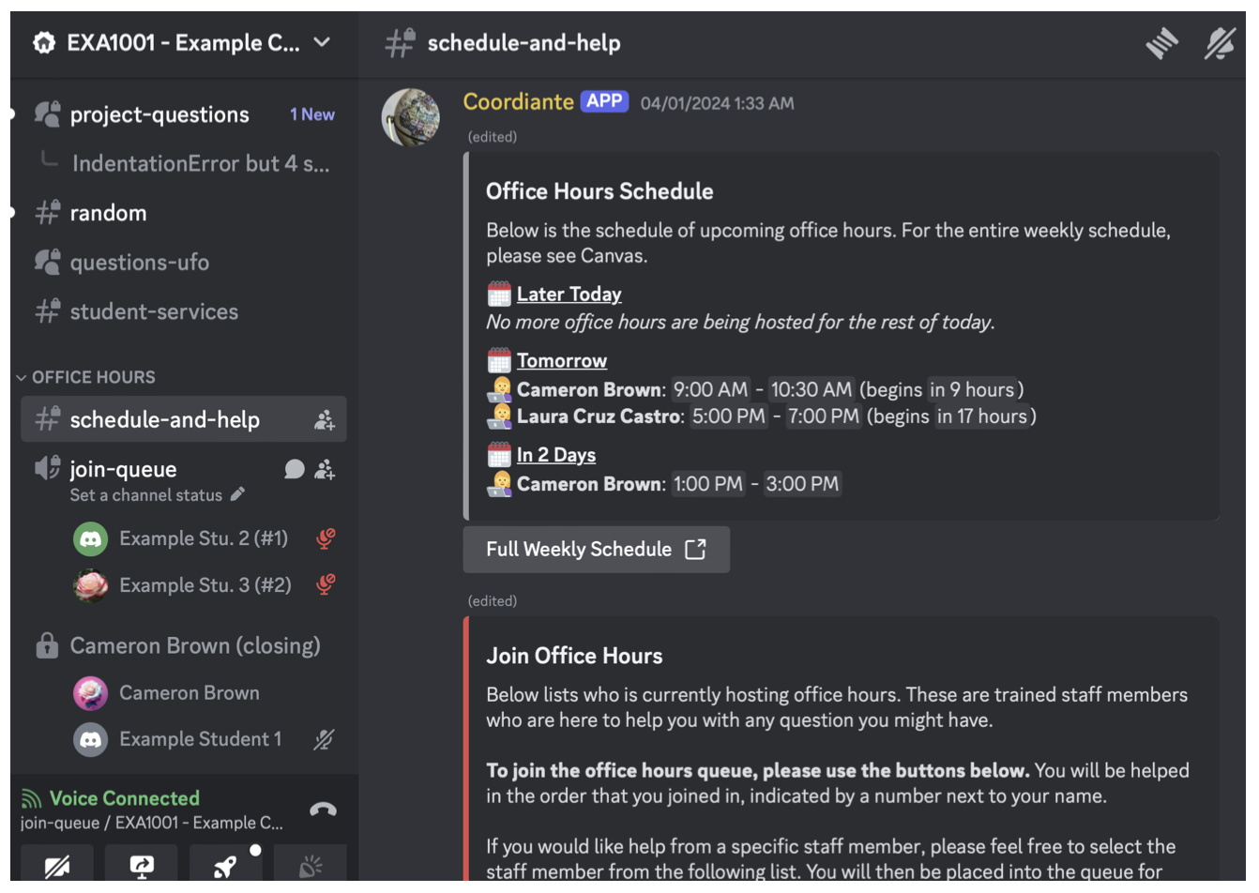
Introducing Discord
Bot integration
Several types of channels
Built-in VoIP
Free for all users!

Slide 10
Coordinate
Discord with extra goodies!
Authentication
Office hours (schedule, breaks, feedback)
Student services (extensions, late pass)
Question management (thread management, staff participation, LLM integration)

Slide 11
Architecture and Features

Slide 12
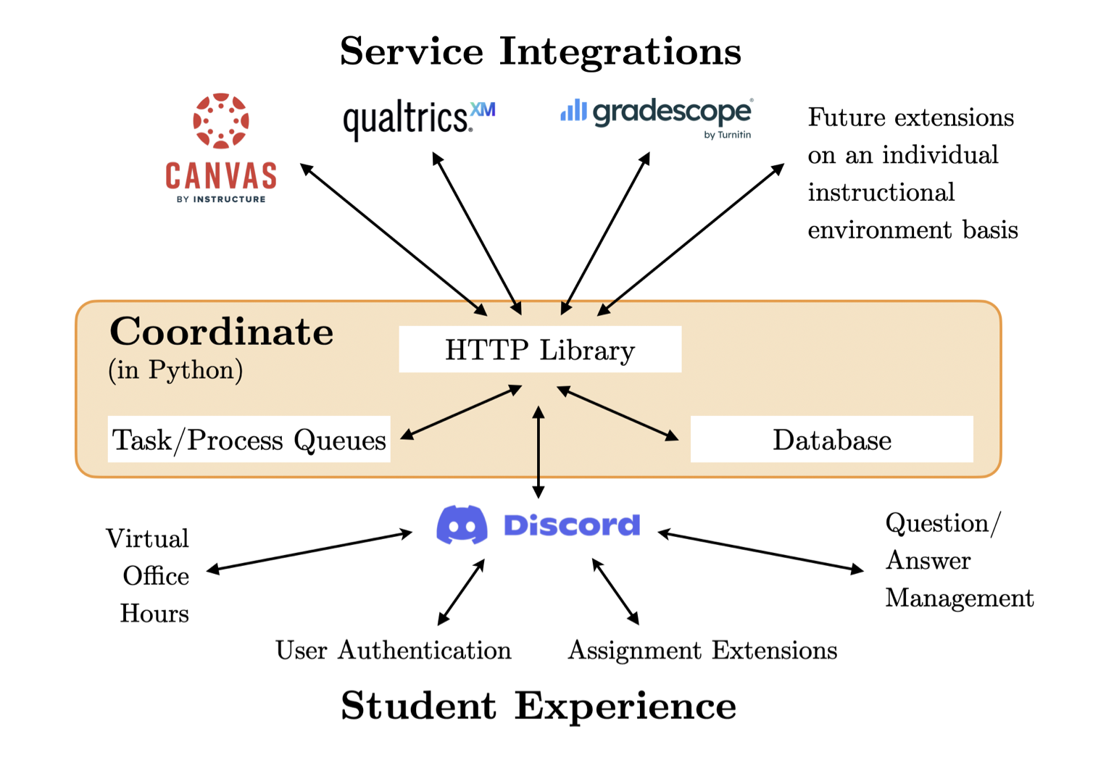
Architecture

Slide 13
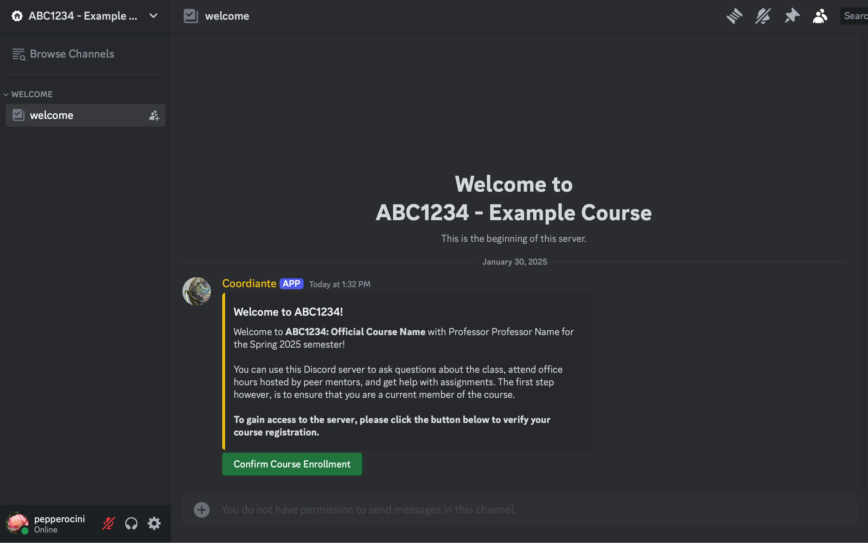
Authentication

Slide 14
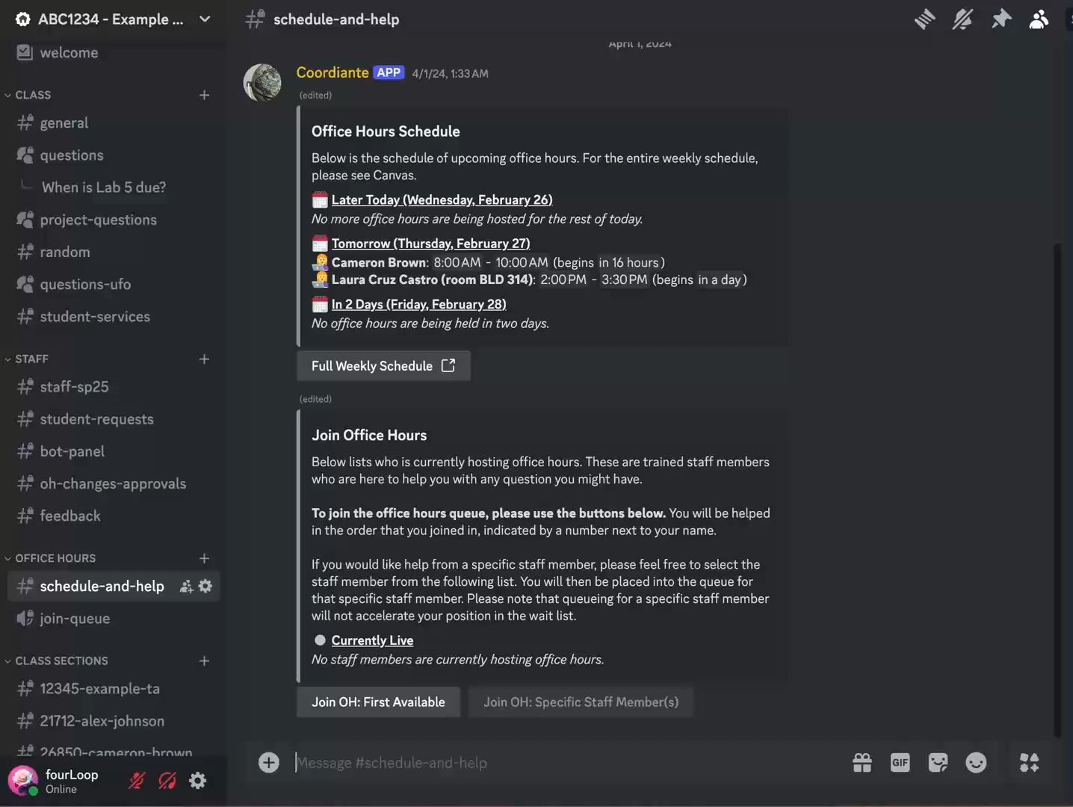
Office Hours: Schedule

Slide 15
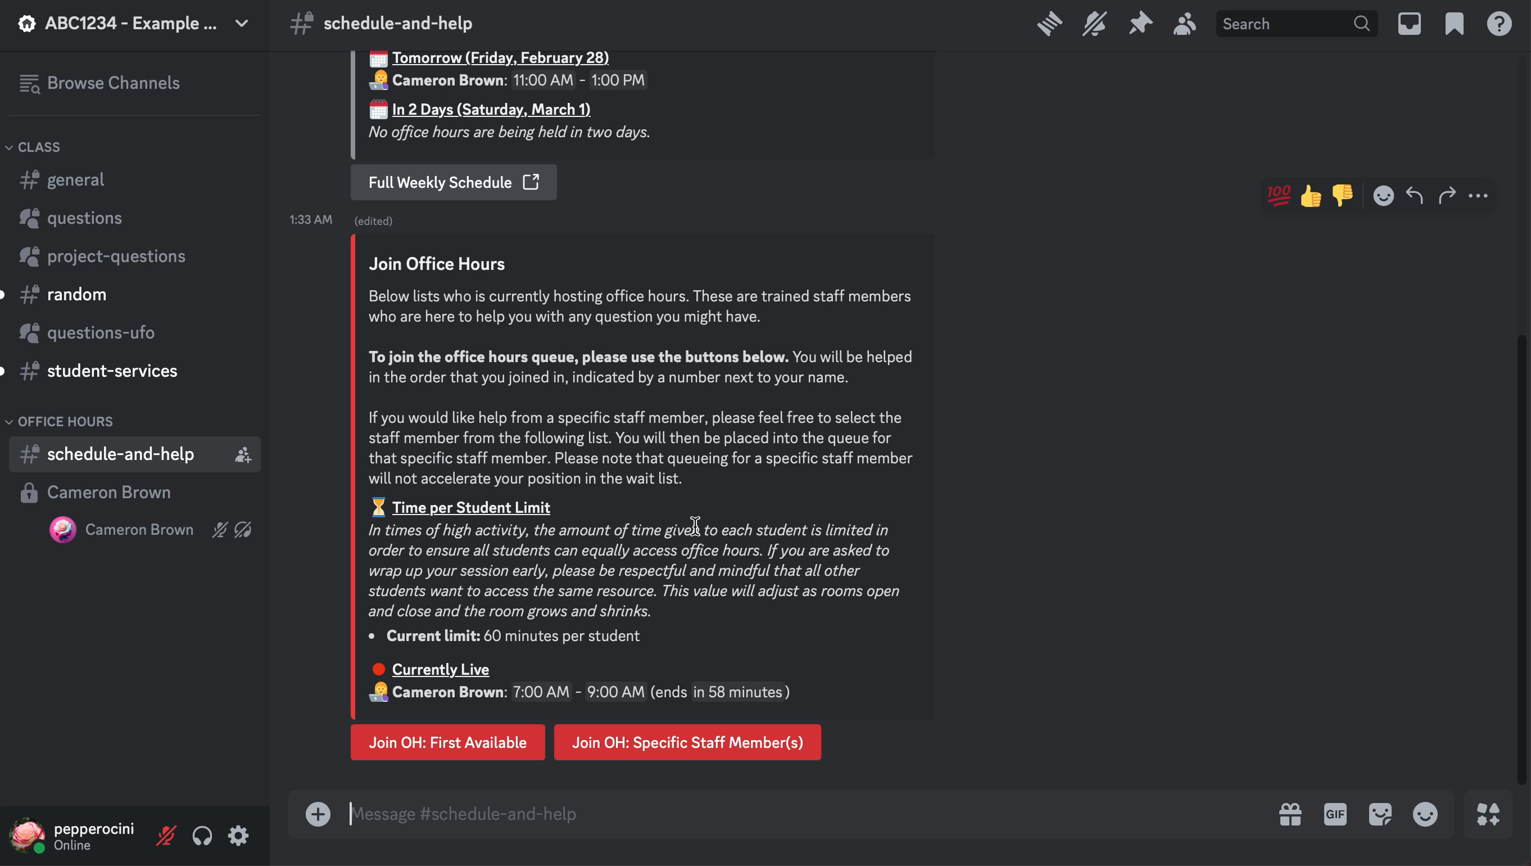
Office Hours: Accepting

Slide 16
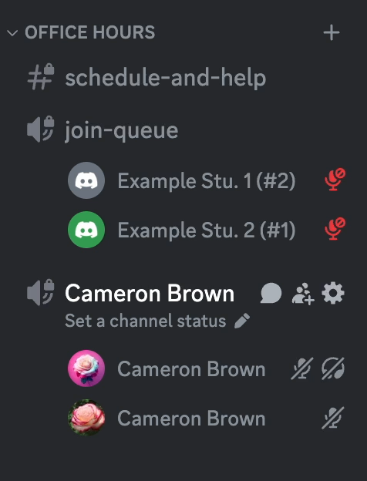
Office Hours: Room Movements

Slide 17
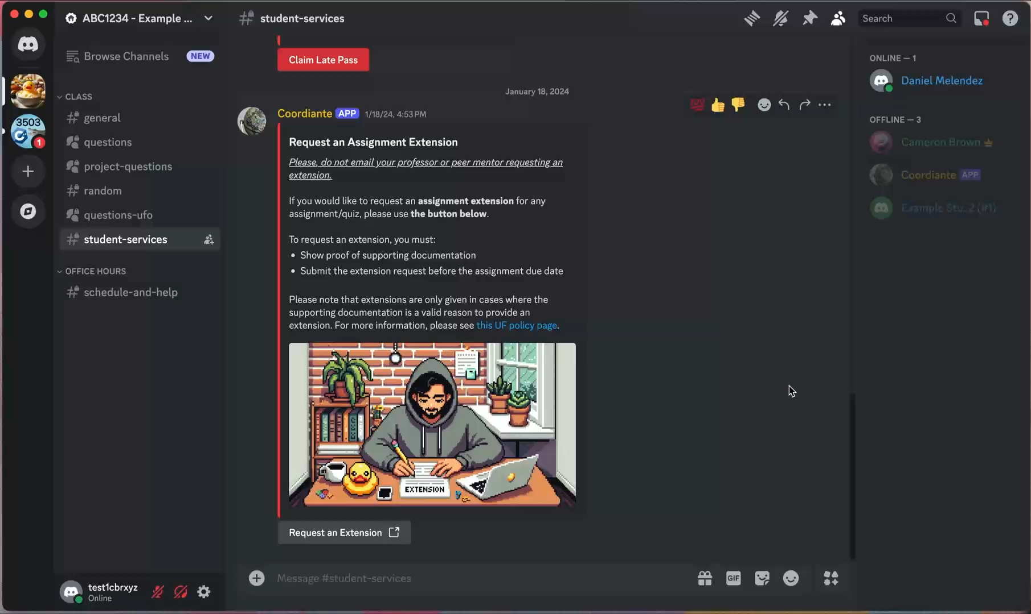
Assignment Extension: Student

Slide 18
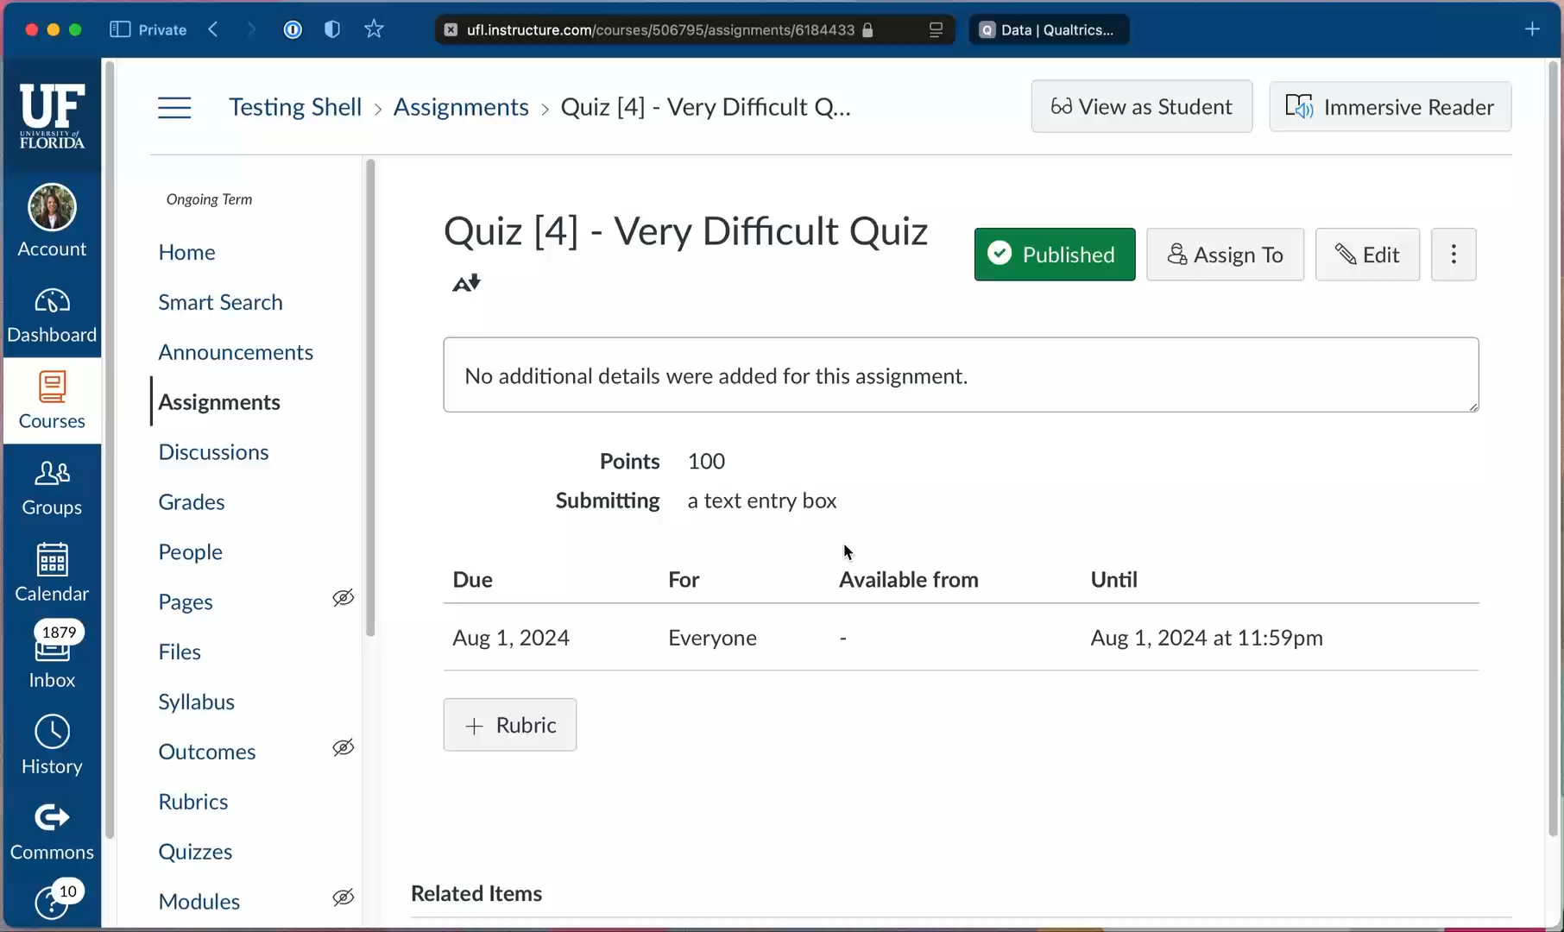
Assignment Extension: Faculty

Slide 19
Tool Deployment

Slide 20
Deployment I (Spring 2023, 2024)
Deployed to one large CS2 class at a public state university
Spring 2023: n = 556
Spring 2024: n = 669
Students were primarily freshmen and sophomores
Prior to this, Slack (chat) and Zoom (office hours) were being used

Slide 21
Spring 2023
78.9% preferred Coordinate to Slack
85% believed it was “easy to use and friendly”
79% preferred Coordinate automated office hours to Zoom office hours
Students' perception:
One student noted, “It boots up quickly, is organized, looks clean,”
Another adds that one benefit is “the questions tab where any TA could help”
One says, “I liked how the queue for all office hours was automatic.”
“I like that other students can answer questions posed in chat. It makes the class feel more collaborative.”
However, they also mention that there were areas for improvement:
“improved management of office hours” and a “more user-friendly interface”

Slide 22
Spring 2024
95.7% of the students preferred using the Coordinate
97.8% believed the platform was user-friendly. In
96.7% of students liked Coordinate over Zoom for office hours.
Students' perception:
“It’s convenient. Most people, myself included, already have Discord open throughout the day, so seeing notifications near instantaneously really helps.”
They like that “It allowed for fast response time”
They find the “office hours system” useful

Slide 23
Deployment 2 (Summer 2024)
Deployed to five smaller summer computer science classes at a public state university
Focusing on primarily instructor feedback
Prior to Coordinate, Slack and Microsoft Teams were being used
All faculty were “highly” or “somewhat satisfied” with Coordinate
3/4 said they would not consider moving to another platform

Slide 24
Conclusion

Slide 25
Conclusion
Students and professors overwhelmingly enjoyed using Coordinate
Students enjoyed the familiarity of the platform
Instructors enjoyed features that reduced their workload
Tools like Coordinate have the potential of off-set the tradeoffs between adopting technology that improves students' engagement and instructional teams benefiting from it
Future work
Adding additional easy course to course customization
LLM-related features
Collaborating with other institutions
Feel free to try out the tool for yourself at your own institution!

Slide 26
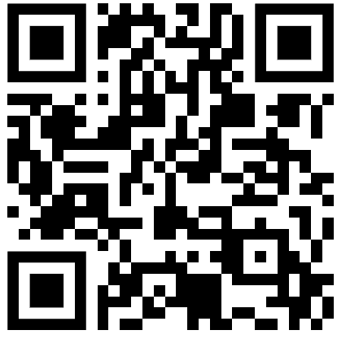
Use in your own institution
All our code is open-source, and can be deployed in your own institution:
https://github.com/cbrxyz/coordinate
Documentation (including setup guides) is available as well: https://coordinate.cbrxyz.com
Build it yourself, or use Docker
GitHub

Slide 27
Acknowledgements
University of Florida Research Foundation (licensing)
HiPerGator at UF (hosting)
Kaleb Smith, NVIDIA (advising)
CISE at University of Florida and ACM-W (funding)

Slide 28
References
Hanke Korpershoek, Truus Harms, Hester de Boer, Mechteld van Kuijk, and Simone Doolaard. 2016. A Meta-Analysis of the Effects of Classroom Management Strategies and Classroom Management Programs on Students’ Academic, Behavioral, Emotional, and Motivational Outcomes. Review of Educational Research 86, 3 (2016), 643–680. https://doi.org/10.3102/0034654315626799
Robert B Kvavik and Michael N Handberg. 2000. Transforming student services. Educause Quarterly 23, 2 (2000), 30–37.
Robert M Bernard, Eugene Borokhovski, Richard F Schmid, Rana M Tamim, and Philip C Abrami. 2014. A meta-analysis of blended learning and technology use in higher education: From the general to the applied. Journal of Computing in Higher Education 26 (2014), 87–122.

Slide 29
References
Rachel Menzies and Mark Zarb. 2020. Professional communication tools in higher education: A case study in implementing Slack in the curriculum. In 2020 IEEE Frontiers in Education Conference (FIE). IEEE, 1–8.
Ari Tuhkala and Tommi Kärkkäinen. 2018. Using Slack for computer-mediated communication to support higher education students’ peer interactions during Master’s thesis seminar. Education and Information Technologies 23, 6 (2018), 2379–2397.
Louis Martin and Dave Tapp. 2019. Teaching with Teams: An introduction to teaching an undergraduate law module using Microsoft Teams. Innovative Practice in Higher Education Journal 3, 3 (2019), 58–66.
Nicolae Dorel Constantinescu. 2015. Piazza–a tool for class discussion. Benefits of its use and future requirements. J Sci Arts (2015), 19–24.
Kathryn Bridson, Jeffrey Atkinson, and Scott D Fleming. 2022. Delivering Roundthe-Clock Help to Software Engineering Students Using Discord: An Experience Report. In Proceedings of the 53rd ACM Technical Symposium on Computer Science Education-Volume 1. 759–765.
Kenrick Mock. 2019. Experiences using Discord as platform for online tutoring and building a CS community. In Proceedings of the 50th ACM technical symposium on computer science education. 1284–1284.

Slide 30
References
Mary Sarah-Jane Gregory and Jason Michael Lodge. 2015. Academic workload: the silent barrier to the implementation of technology-enhanced learning strategies in higher education. Distance Education 36, 2 (2015), 210–230. https://doi.org/10.1080/01587919.2015.1055056

